Slide 1

ROM, PLA, PAL, ALU
CSE 4205 Digital Logic Design
Course Teacher: Md. Hamjajul Ashmafee
Lecturer, CSE, IUT
Email: ashmafee@iut-dhaka.edu

Slide 2
Remaining to Add
Review other books and internet resources
Notes:
What is digital computer? Examples where we can use this thing.

Slide 3
Introduction
With the advent of large-scale integration technology, it is feasible to fabricate large circuits within a single chip
A consequence – Programmable Logic Devices (PLD)
A kind of LSI
A combinational circuit to implement a set of Boolean functions
Advantages of PLDs:
Reduced space requirements
Reduced power requirements
Design security
Compact circuitry (Higher density)
Short design cycle – [Analysis, Design, Development, Testing, Deployment]
Higher switching speed (toggling speed)
Low production cost for large quantity production

Slide 4
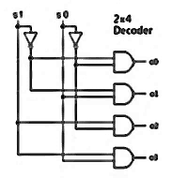
Concept to Produce PLDs
Normally Boolean functions are expressed by sum of product forms or sum of required minterms
A decoder can be used to generate 2^{n} minterms for n inputs
One or more OR gates are required to generate the expected function
IC packages (PLDs) are developed with larger integration of decoders and OR gates to generate one or more required outputs at a time
Advantage: Reduce the broad space, interconnections and power consumption
Specially they are used as a memory device
In spite of being combinational circuit devices

Slide 5
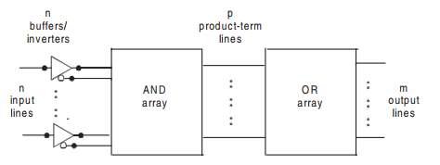
General Structure of PLD
Product term production
Sum term production
Notes:
Each input has its own buffer and inverter internally – So only regular inputs (e.g. x) is required to input

Slide 6
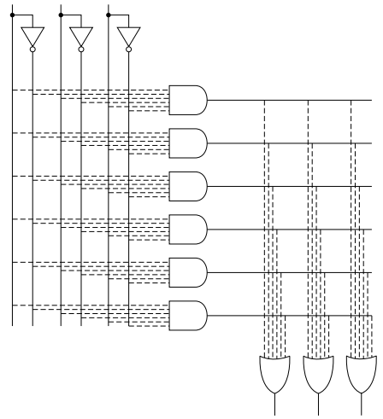
Internal Structure of PLD

Slide 7
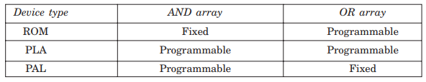
PLD Classification and Summery
Read Only Memory (ROM)
Programmable Logic Array (PLA)
Programmable Array Logic (PAL)

Slide 8

Concept: Programmable Array
In a programmable array, the connections of gates are flexible
To implement a programmable gate, a fuse link is employed
Example: a programmable input to an AND gate
Some of the fuses are blown out to achieve the desired output of the gate
Notes:
Open inputs (blown out) are not undefined after removing rather they are connected as:
Logic-1 for AND gate
Logic-0 for OR gate

Slide 9

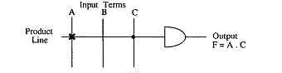
PLD Notation
To simplify the representation of PLD connection:
A single line is drawn into the logic gate where the inputs are shown with perpendicular lines
The connected inputs are indicated by cross (x) at the junctions [fusible] and unconnected inputs are left blanks
Sometimes junctions are presented with ‘bold’ dots indicating permanent junctions

Slide 10
PLD Types in Details

Slide 11
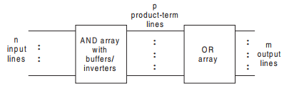
Read Only Memory (ROM)
Common Notation – 2^{n} x m ROM
n input lines and m output lines
2^{n} intermediate ANDed (i.e. product/minterm) terms which are fixed
m outlines lines are programmable
Also, this notation is considered as total number of bits stored.
Also, 2^{n} denotes the total number of addresses and m denotes the total number of bits per word
A two level logic representation in sum of minterms form
Block Diagram:

Slide 12
ROM…
Once a pattern is established, it would be erased even if power supply is off (Non- volatile)
Bit combination of n input variables are called addresses
Each address combination (one of the minterm) is connected with required output lines (m bit) to make a specific word – n-bit long address
Each bit-combination of output lines is called a word – m-bit long word
Example:
32x8 ROM = 2⁵x8 ROM = 5 input variables, 32 addresses and word length = 8

Slide 13
ROM with Decoder
A decoder could be used to implement a ROM
Decoder – a combinational circuit that generates 2^{n} number of minterms from n input variables
Each minterm then is applied to required number of OR gates using fusible links which could be blown up selectively as per requirement (shown in logic diagram)
Decoder

Slide 14
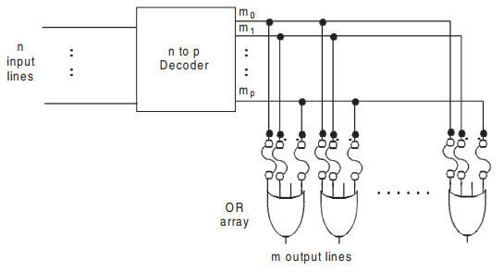
2^{n}xm ROM: Logic Diagram

Slide 15
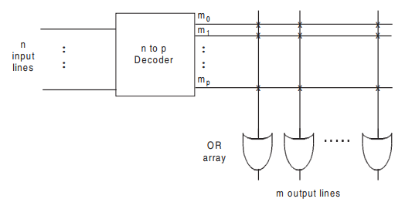
2^{n}xm ROM: Logic Diagram with PLD Notation

Slide 16
ROM: Applications
Basically to design different components of a digital computer system like:
Complex combinational circuit
Code conversion
Bit pattern generation for characters
Multipliers
Look up table
Especially they are used as a multiple-output combinational circuit with same set of inputs
Storage of a fixed bit pattern – memory storage ROM
Also, used with microprocessors and microcontrollers

Slide 17
ROM: Implementation
Similar to the application of decoder along with an OR gate
Within a single chip
A set of Boolean functions should be expressed with minterms or a truth table
No further simplification is required
A ROM should be selected with required number input (n) and output lines (m)
Blowing off the appropriate fuses (an open terminal) is referred to as programming
Note 1: Open terminal with AND logic gate behaves like logic-1
Note 2: Open terminal with OR logic gate behaves like logic-0
A ROM program table (or truth table) should be specified for required paths in it

Slide 18

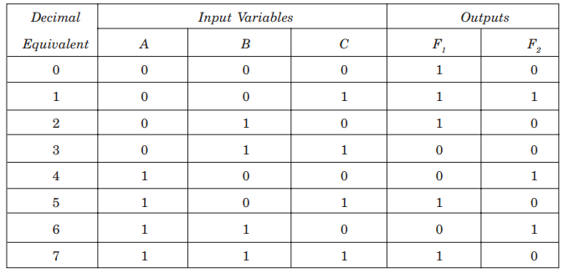
ROM: Example Too simple to implement with a ROM
i.e. a 2³x2 or 8x2 ROM is required.
Program table or truth table for ROM:
Notes:
Practically, a ROM is implemented for a very complex combinational networks having a large number of inputs and outputs

Slide 19
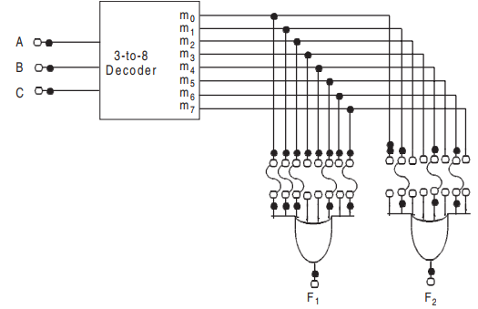
ROM: Example…
Logic diagram:

Slide 20
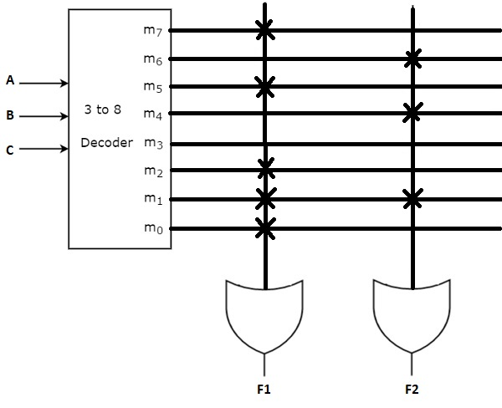
ROM: Example…
Logic diagram with PLD notation :

Slide 21
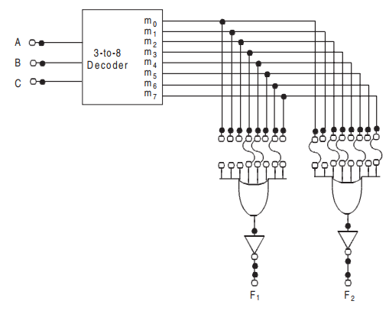
ROM: Example…
Some ROMs are available with inverter logic gate (NOT) with each OR gates
Then those minterms should be blown off which are logic-1 in the truth table
Implementing F’ functions with less number of minterms

Slide 22
ROM: Types
Types of programming:
Mask Programming:
Done by manufacturer
Field Programming:
Done by user by means of following certain procedures and having programming equipment
Types of ROM (field programmable):
PROM – programmable only once
EPROM – erasable with UV light chamber
EEPROM – resettable to the original state of 1s and 0s with a special electrical signal

Slide 23
Programmable Logic Array (PLA)
Motivation:
A combinational circuit may contain don’t care conditions which will never occur
A waste of memory considering don’t cares as valid minterms
Example: Code conversion from BCD to Excess 3 where 6 addresses will not be used for a 16x4 ROM
A waste of 6x4 bit locations
PLA (kind of LSI) is more economical to use where don’t care cases are excessive

Slide 24
Concept of PLA
PLA doesn’t produce all minterms like ROM or decoder
Rather some essential AND gates with buffer/inverters are used to generate some required product terms
These product terms are used to realize the expected output functions in turn.
Here, Boolean functions are implemented in sum of products form rather than sum of minterms form
The AND and OR gates are fabricated with fusible links inside the PLA
All inputs to the AND and OR gates have fusible links
Even the outputs have inverter (NOT gate) with fusible links to be available both in F and F’ format
The required functions are realized opening (blowing off) required links
Notes:
Total number of inputs of any AND gate is not important here because all the inputs are present in both forms to each AND gates to be considered or skipped

Slide 25
Concept of PLA…
Common notation: n x p x m
n = number of inputs
p = number of product terms
m = number of outputs (or sum terms)
Total number of programmable links = 2n x 2p x 2m
The basic difference between ROM and PLA is in the number of the product term
i.e. 2^{n} (ROM) >> p (PLA)
e.g. 16 x 48 x 8 PLA. Here the number of product term is drastically reduced

Slide 26
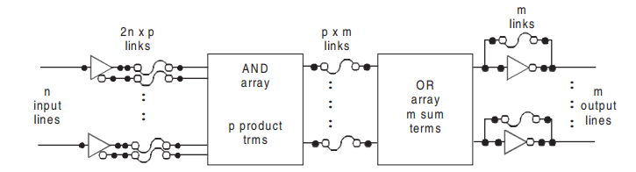
PLA: Block Diagram

Slide 27
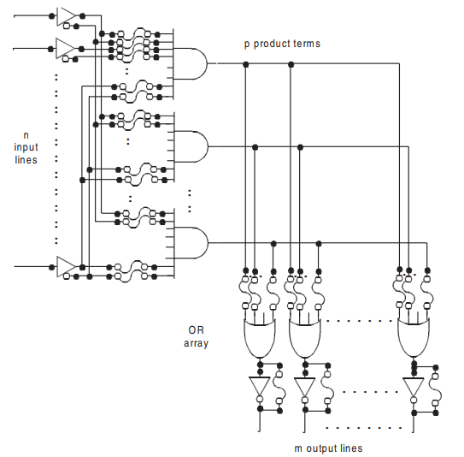
PLA: General Structure or Logic Diagram

Slide 28
PLA: Types
Types of programming:
Mask programming
User must provide the PLA program table to the manufacturer
Field programming
User can program it by means of certain procedures and equipment

Slide 29
PLA: Implementation
Constraint: All minterms are not present in the AND array like ROM
So, SOP is more preferred over SOM [standard form over canonical form]
Some degree of simplification of Boolean functions is required to meet the required number of product terms
Extra intelligence is required to choose between F and F’
So that the number of product terms does not exceed the number of AND gates
Notes:
Total number of inputs of any AND is not important here as all the inputs are present in both forms to each AND gates
So to get the fewest number of product terms, simplified expressions for both F and F’ are required
Here, an important point is that we are implementing multiple outputs circuit, so we can observe whether any term could be common or not

Slide 30

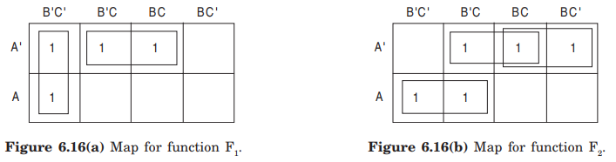

PLA: Example Too simple to implement with a PLA
Example: Use a 3 x 4 x 2 PLA to implement the following Boolean expressions
To get required and reduced product terms, simplified expressions are:
Notes:
Here total number of different minterms is 6, whereas the given number of AND gates is 4. So simplification is required.
Though the total number of product terms of F1 and F2 is 5, A’C is common for both expressions
Moreover, if the number of AND gates were less, we would better choose alternative to implement them.

Slide 31
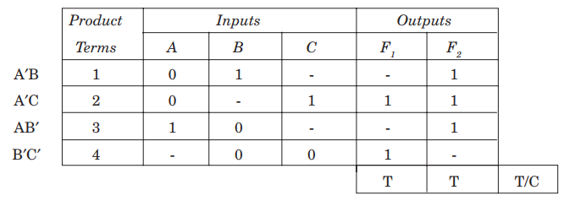
PLA: Example…
PLA program table
T = in its original form, inverter is blown up
C = in its complement form, inverted is used
Notes:
Program table is required to specify the input-output relationship to each AND and OR gates
It is required to derive the necessary distinct product terms as well as their total number
It is also required to specify whether the output is expressed in F or F’
Second columns for Inputs refers the paths between inputs and AND gates
Third column for Outputs refers the paths between AND and OR gates

Slide 32
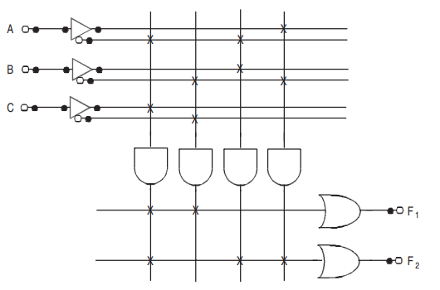
PLA: Example…
Internal connections of PLA with PLD notation:

Slide 33
Programmable Array Logic (PAL)
General structure of PAL is very similar to PLA
But, only difference between these is in a PAL device, only AND gates are programmable whereas OR gates are fixed by manufacturer.
So, PLA is less expensive, more flexible and more easier than PAL

Slide 34
Concept of PAL
External inputs are connected with the AND gates with programmable links
Whereas, the output of AND gates are fed to OR array with fixed connections
All the AND outputs are not fed to all OR gates
Rather, few AND outputs are connected to an OR gate based on the manufacturer’s direction (Figure shown)
Similar n x p x m notation for PAL as PLA:
n = number of inputs
p = number of product terms
m = number of outputs (or sum terms)

Slide 35
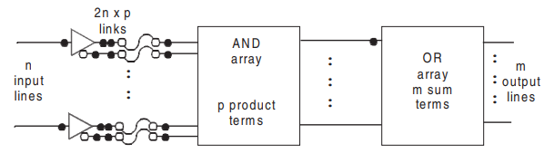
PAL: General Structure
Notes:
Here the bold dots with OR array denotes the fixed connections

Slide 36
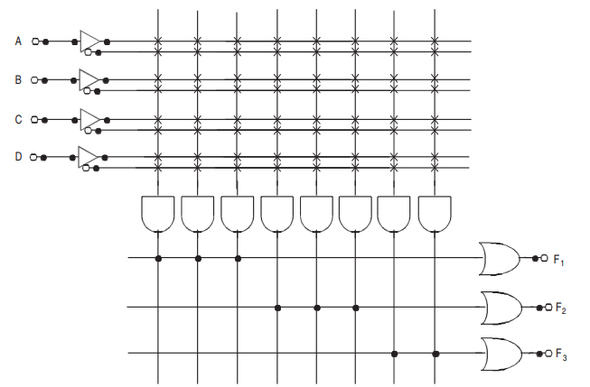
A Generic 4 x 8 x 3 PAL
Notes:
Here all AND outputs are not connected to all OR gates
Rather it follows the manufacturer’s guidance to connect few AND outputs to an OR gate permanently (fixed)
F1 has three AND gates, F2 has three AND gates and F3 has two AND gates (fixed)

Slide 37
PAL: Implementation
Some degree of simplification is required to reduce the total number of product terms

Slide 38

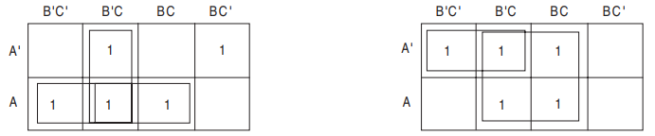

PAL: Example with a 4 x 8 x 3 PAL Too simple to implement with a PAL
Example: Use a 4 x 8 x 3 PAL to implement the following Boolean expressions
To get required and reduced product terms, simplified expressions are:
Notes:
Though the PAL has 4 inputs, originally the number of inputs here = 3

Slide 39

PAL: Example with a 4 x 8 x 3 PAL…
But, in the specified PAL, there is no OR gate with 4 product terms
So alternative realization could be:
Now these three functions could realize the specified Boolean expressions where F₃ (sub-function) has to be inserted as input to the F₁ again
Where

Slide 40
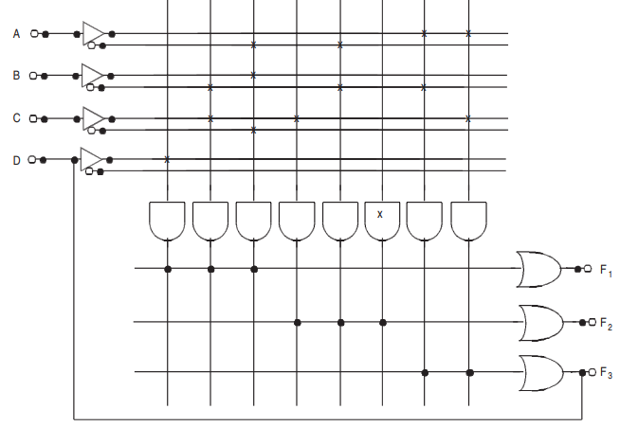
PAL: Example with a 4 x 8 x 3 PAL…

Slide 41
Other PLDs
Registered PAL devices
For sequential circuits
Generic Array Logic Devices (GAL)
Field Programmable Gate Array (FPGA)

Slide 42
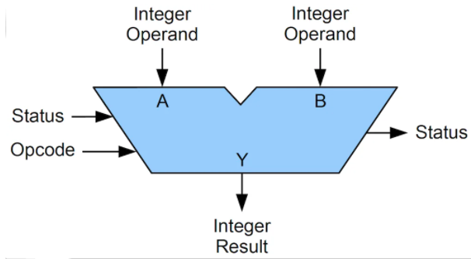
ALU as Logic Device
ALU is a part of CPU that performs the calculation and condition testing
Considered as fundamental building block of CPU

Slide 43
ALU: Basic Concept
Consists of millions of transistors
Performs:
Arithmetic operations – Add, subtract, …
Logical operations – AND, OR, Rotate, Shift, …

Slide 44
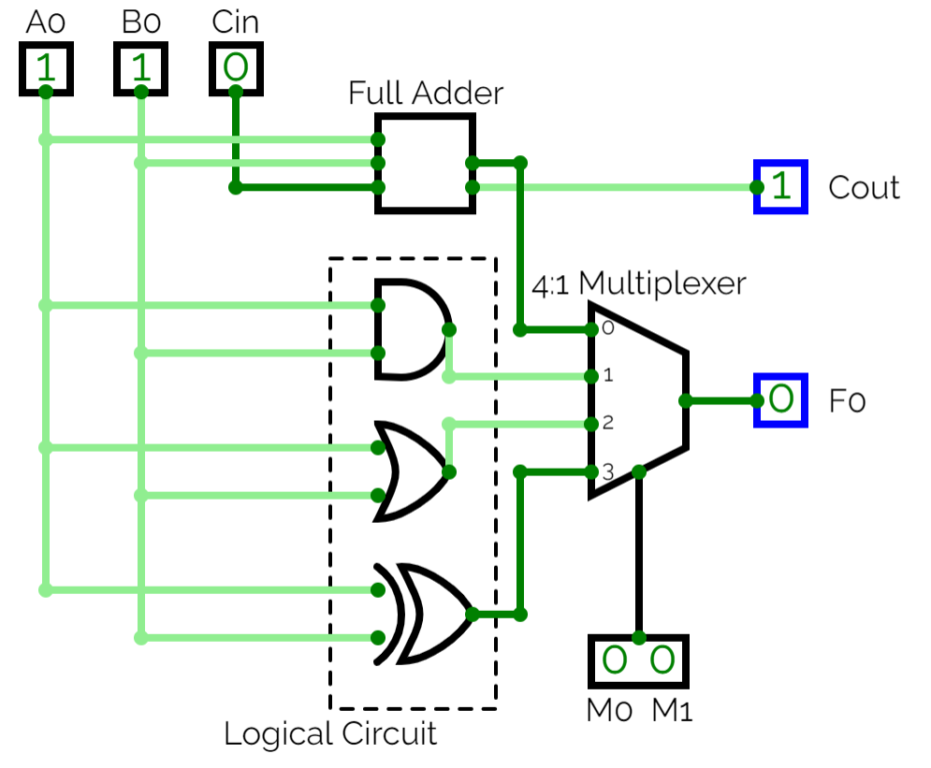
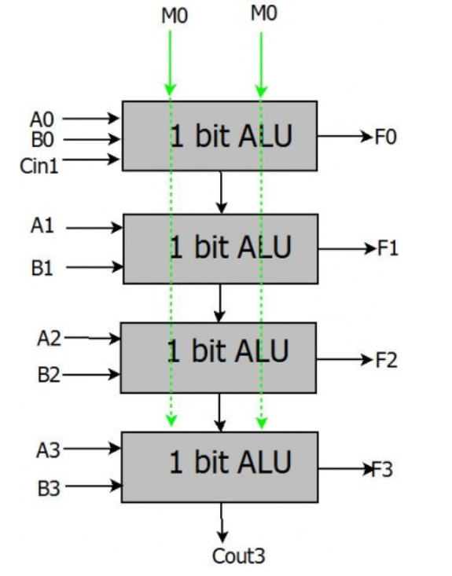
ALU: Example of ALU
Circuit Diagram
of 1-bit ALU
Block Diagram
of multiple 1-bit ALUs
Notes:
Figure 1: Internal circuit diagram of an 1-bit ALU
Figure 2: 4-bit adder with 4 ALUs

Slide 45
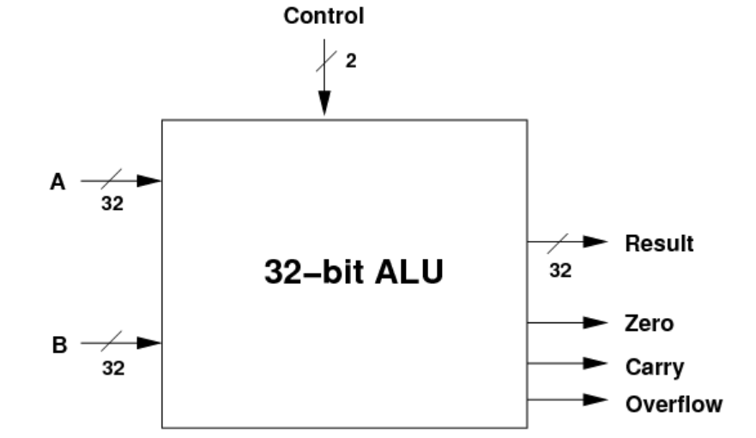
ALU: More Complex Example

Slide 46
ABC
abc

Slide 47
ABC
abc

Slide 48
ABC
abc

Slide 49
ABC
abc

Slide 50
ABC
abc

Slide 51
ABC
abc

